Slide 1
Embedded Linux for Zynq 7000 / Zynqmp with Vitis 2022.1 and Buildroot
The Advanced Engineering Course
Aleksei Rostov, PhD,
Senior R&D Engineer,
FPGA/Embedded Linux Developer,
aleksei.rostov@protonmail.com

Slide 2
Agenda
Introduction
System software for Linux Image
FSBL, Device tree, U-Boot
Buildroot for rootfs
Application development for AXI MM IP cores
Application development for serial interfaces (I2C, SPI, …)
Application development for AXI DMA IP core
aleksei.rostov@protonmail.com

Slide 3
Introduction. System software for Linux Image
Xilinx SDK, Vivado, Vitis IDE
FSBL
Bitstream
ARM cross-compiler
Linux kernel
Rootfs
Buildroot
U-Boot
Device tree
Kernel Modules
Linux Application
Device tree
PMU Firmware
ARM Trusted Firmware
Zynq 7000
FSBL
Bitstream
Zynq Ultrascale+
FSBL
Bitstream
U-Boot
PMU, ATF
U-Boot
Devicetree
Kernel
Rootfs
Devicetree
Kernel
Rootfs
Tools for getting the set of Linux Image files
A set of Linux Image files for Zynq 7000 / Ultrascale+
aleksei.rostov@protonmail.com

Slide 4
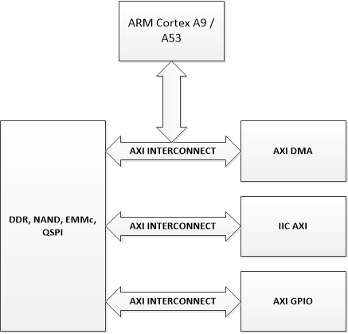
Introduction. Application development for Linux
AXI GPIO, AXI IIC, AXI DMA
Drivers for Standalone
Drivers for Linux
User Space
Kernel Space
An example of hardware design
Working with axi memory mapped devices
aleksei.rostov@protonmail.com

Slide 5
System software. FSBL, Device tree, U-Boot, PMU, ATF
Bitstream, FSBL, PMU, device tree
ATF, u-boot
BOOT.BIN file for loading Linux from MicroSD, QSPI, Ethernet
Steps (for bitstream, fsbl, pmufw, device tree) by using Vivado 2019.1, Xilinx SDK 2019.1 :
Create hardware design in Vivado and export the design to Xilinx SDK (.bit file)
Fetch source for device tree from Xilinx GitHub (Device Tree generator plugin for xsdk) and add to Xilinx SDK
Compile fsbl, pmufw and generate device tree files (fsbl.elf, pmufw.elf, .dts, .dtsi)
Steps (for ATF and u-boot) by using ARM cross compiler:
Fetch sources: Device Tree compiler (required to build U-Boot), ARM Trusted Firmware, The u-boot bootloader with Xilinx patches and drivers, arm compiler for 32 and 64 bit
Prepare include and device tree files for u-boot (.h, .dts)
Compile ARM Trusted Firmware (bl31.elf) and u-boot (u-boot.elf)
aleksei.rostov@protonmail.com

Slide 6
System software. Buildroot with out-of-tree
BOOT.BIN
BIT
Kernel
Device tree
FSBL
PMU, ATF (for ZU+)
U-boot
Linux Image
rootfs
Linux Image (Image.itb)
Kernel (Image.gz)
Device Tree (devicetree.dtb)
File System (rootfs.cpio.lzma)
All files required for booting Linux on Zynq 7000/ Zynq Ultrascale+
Set of the Linux Image Files from Buildroot
aleksei.rostov@protonmail.com

Slide 7
Kernel Module development for AXI MM IP core

Slide 9
Kernel Module development for I2C interfaces

Slide 10
Instruments and Structure of course
Vivado 2019
Vivado IDE
Vivado HLS
MATLAB 2019b
Petalinux 2019
Xilinx SDK 2019
Github
VMware Workstation
IDEs/Instruments
Course structure
Programmable logic
RTL design for DSP
Vivado HLS for DSP
Processing systems
(Zynq 7000 ZynqMP Ultrascale+)
Standalone / RTOS
Linux OS
aleksei.rostov@protonmail.com

Slide 11
HARDWARE DESIGN EXAMPLES
Processing system with integrated programmable logic
Example of DSP digital system for RTL design
aleksei.rostov@protonmail.com

Slide 12
GIT structure with folders
Presentation
Introduction.pptx
Others
scripts
Vivado
vivado.sdk
vivado.runs
vivado.sim
MATLAB
dsp.m
AnyFile.bin
aleksei.rostov@protonmail.com

Slide 13
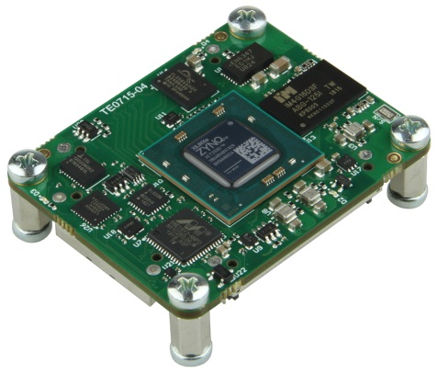
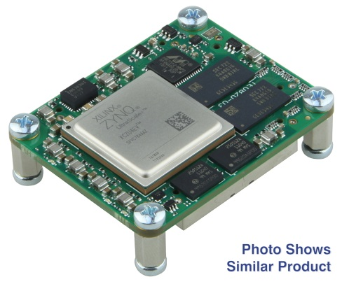
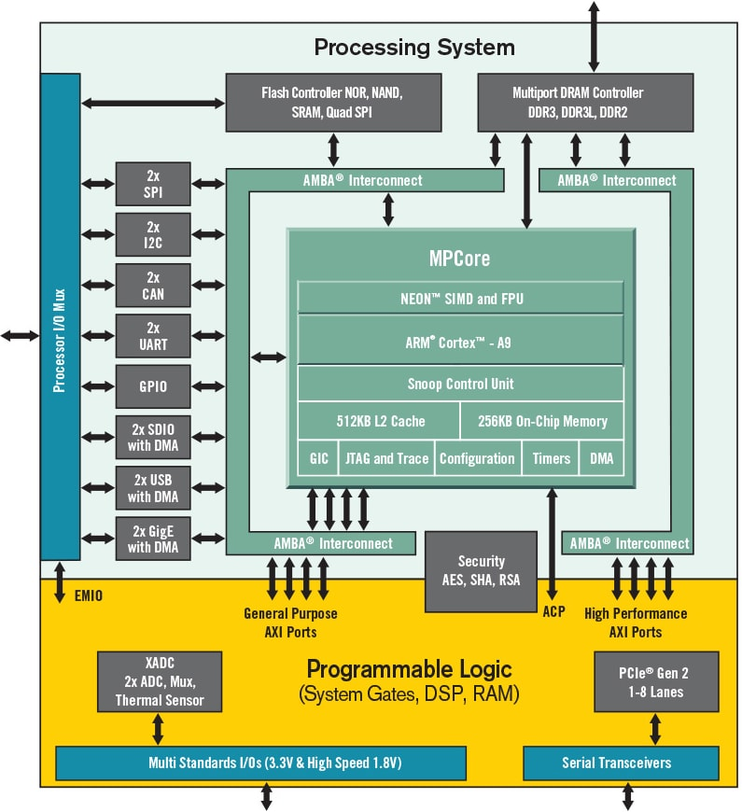
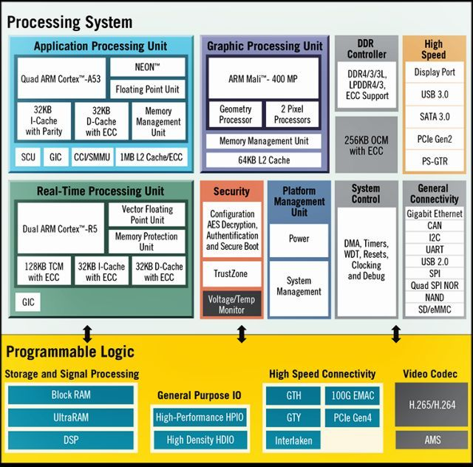
Xilinx SoC Zynq 7000
Xilinx MpSoC Zynq Ultrascale+
aleksei.rostov@protonmail.com

